Slide 1

Congratulations on installing
Let’s take a quick tour of the main features.

Slide 2
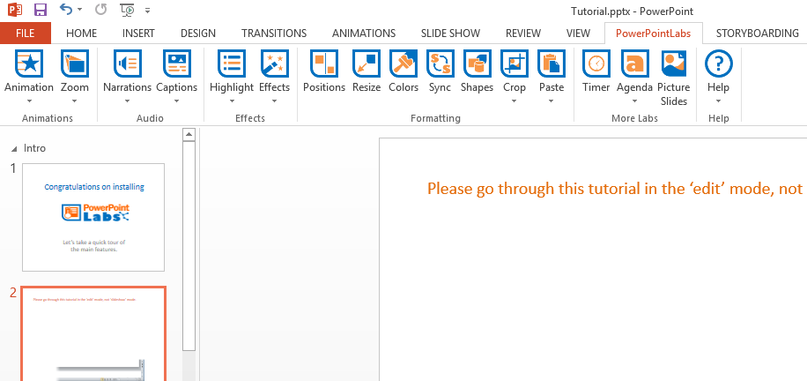
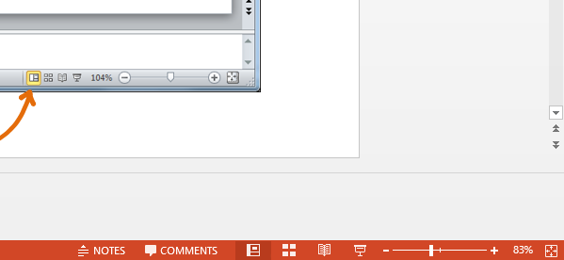
Please go through this tutorial in the ‘edit’ mode, not ‘slideshow’ mode.

Slide 3

This tutorial explains PowerPointLabs’ features at the point you installed the add-in. You can view this tutorial anytime by clicking the button and selecting .
If you installed the add-in some time back, please refer to the Documentation page of our website for more up-to-date instructions.

Slide 4
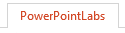
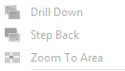
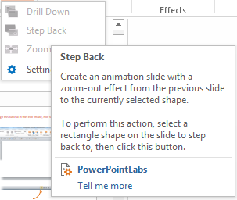
Before we start, select the ribbon. This is where you can find all the features of PowerPointLabs.
Some buttons may appear disabled like this:
That is because a button is enabled only when it can be used. This tutorial will show you when they can be used. You can also hover your cursor over a button to see how to use it.

Slide 5
First, let’s try using Animation Lab

Slide 6


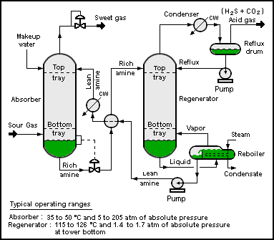
Animate In Slide
1. Select the four blue circles in any order (ctrl-click), click the button and select .
2. When you ‘play’ the slide show ( ), you should see a single circle animated in the order of your selections.
Notes:
Picture credit: Wikipedia

Slide 7

Add Animation Slide
1. Let’s say you want to animate these shapes so that they end up in the positions given in the next slide.
Research
Marketing
Profit
2. While this slide is selected, click the button and select .
That should insert a new slide containing the animation.
Development

Slide 8
Research
Marketing
Development
Profit
To find out more about Animation Lab, please refer to PowerPointLabs documentations.

Slide 9
Now, let’s try using Tooltips Lab

Slide 10
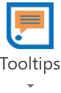


Create Tooltip
1. There are different ways you can use Tooltips Lab. The simplest way is to generate the original trigger and callout pair. Click on the button and then select .
2. There will be a trigger and callout pair created for you. You can shift them to your desired position. When you ‘play’ the slide show ( ), you can click the trigger and the callout will appear. A second click on the trigger will cause the callout to disappear.
There are other ways to generate tooltips. For example, you can convert an existing shape to a trigger/callout of a tooltip. For more information, refer to the Tooltips Lab user guide.

Slide 11
Next, let’s try using Zoom Lab

Slide 12





Drill Down
1. Select the blue rectangle, click the button and select to generate a drill down effect to the next slide.
Inputs
Process
Output
Ingredient A (60%)
Ingredient B (25%)
C (15%)
2. Press the button to see drill down effect generated by PowerPointLabs. The effect tells the audience which part of this slide corresponds to the content of the next slide. For example, here it gives audience the feeling that you are now drilling down to details about the “Process” part of this slide.

Slide 13
L
X
Y
Z
M

Slide 14

Step Back
3. Select the blue rectangle, click the button and select to generate a step back effect from the previous slide.
Inputs
Process
Output
Ingredient A (60%)
Ingredient B (25%)
C (15%)
4. Go back a couple of slides and press the button to see the step back effect generated. This effect can be used to indicate that you are stepping back to take a look at where the details you have been discussing fit into the big picture.

Slide 15

Zoom To Area
1. Select the blue rectangles in any order (ctrl-click), click the button and select .
2. Press the button to see the zoom and pan effects generated by PowerPointLabs.

Slide 16
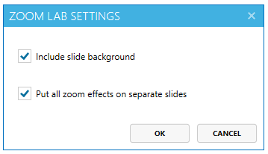
3. If you would like all zoom/pan effects to be put in a single slide, click the button and select . The following pop up should appear.
Uncheck “Put all zoom effects on separate slides” option.
To find out more about Zoom Lab, please refer to PowerPointLabs documentations.

Slide 17

Next, let’s try using e-Learning Lab

Slide 18


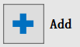
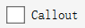
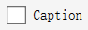
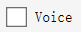
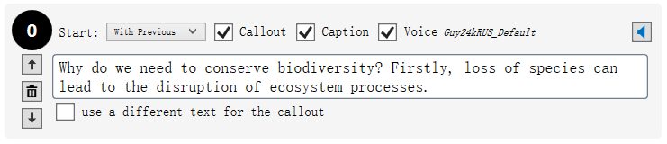
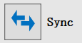
1. Click the button and select to open e-Learning Lab task pane at the right side of your screen.
Add a new explanation item by clicking on button.
2. Type something into the text box and tick , and checkboxes.
3. Click the button to synchronize the new explanation you added with the slide.
4. Now, play the slide in presentation mode and observe the changes.

Slide 19
Next, let’s try using Narrations Lab and Captions Lab

Slide 20


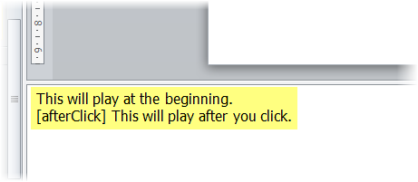


Generate Audio Automatically
1. Click the button and select . This will generate an audio narration for this slide based on the slide notes. Press the button to play the slide and listen to the generated audio narration.
Add Captions
1. Click the button and select to generate subtitles (captions) as well. Press the button to play again to experience both audio and captions at the same time.
Tip: You can select multiple slides and apply the above two effects to all selected slides.
Notes:
This will play at the beginning.
[afterClick] This will play after you click.

Slide 21

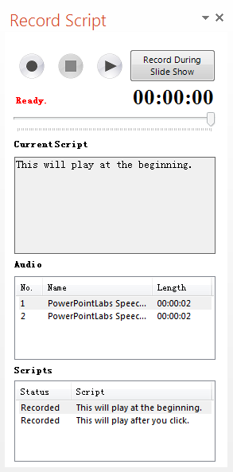


Record Audio Manually
1. Click the button and select to record an audio in your own voice. It will show Recorder Script Pane at right side of your screen, showing the recording status of the scripts of current slide.
2. Click on the script you want to record and
click button to start recording. When you
click button, the record will be auto-
embedded on the slide, and you can check it in the panel.
To find out more about Narrations Lab, please refer to PowerPointLabs documentations.
To find out more about Captions Lab, please refer to PowerPointLabs documentations.
Notes:
This will play at the beginning.
[afterClick] This will play after you click.

Slide 22
Next, let’s try using Highlight Lab

Slide 23


Highlight Points
1. Click the button and select .
A bullet point
Another bullet point
A sub-bullet point
A third-level bullet point
One more bullet point
2. Press the button to see how each bullet point is highlighted one at a time.

Slide 24

Highlight Background
1. Click the button and select .
A bullet point
Another bullet point
A sub-bullet point
A third-level bullet point
One more bullet point
2. Press the button to see how the background of each bullet point is highlighted one at a time.
To find out more about Highlight Lab, please refer to PowerPointLabs documentations.

Slide 25
Next, let’s try using Effects Lab

Slide 26



Make Transparent
1. Select the picture below, click the button and select .
Tip: After a picture has been made transparent, you can adjust transparency by right-clicking the picture and choosing format picture → fill.

Slide 27


Magnifying Glass
1. Select the blue circle below, click and select to create a magnified version of the area covered by the circle.
Tip: You can resize the newly created shape to match the magnifying level you need

Slide 28

Spotlight
1. Select the blue shape, click the button, select the dropdown menu and select .
Phase A
Phase B
Phase C
Step 1
Step 2
Step 3

Slide 29
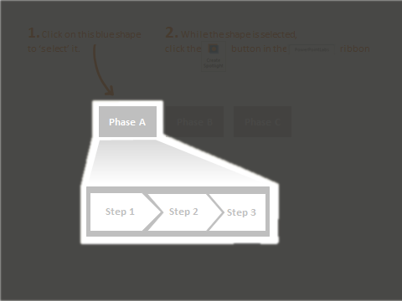
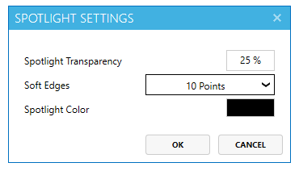
2. Did you notice the new slide with a spotlight? You can press ctrl-z (Undo) to reverse the effect.
3. You can also adjust the darkness (transparency), softness of the edges and the color of the spotlight.
Under the dropdown menu, select to open the following pop up.
Note: the changed settings are applied to spotlights you create in future, not the existing ones.

Slide 30

Blur Selected
1. Select the blue circle below, click the button and select to blur the area around the selected shape. A new slide with the desired effect will be created.
Tip: You can apply these two effects to multiple shapes too. Just select the relevant shapes before clicking the button.

Slide 31
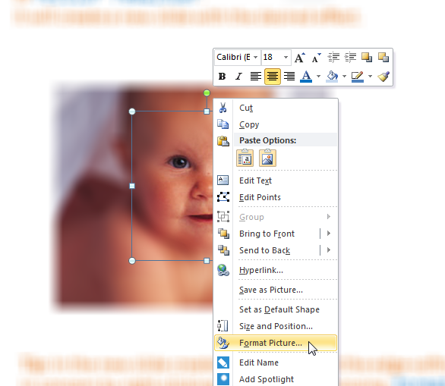
Tip: In the new slide created, you can adjust the edge-softness of the circular area in concern by right-clicking that area and choosing format picture → glow and soft edges.
To find out more about Effects Lab, please refer to PowerPointLabs documentations.

Slide 32
Next, let’s try using Positions Lab
Positions Lab provides the tools for you to perfectly align all the objects in your slide

Slide 33

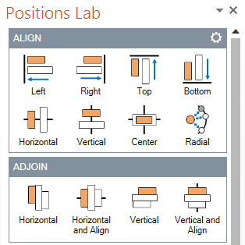
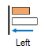
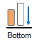
1. Click the button to open the Positions Lab pane at the right side of your screen.
We will first try the Align feature, which makes it easy to align objects on a slide. Note that the objects are aligned with reference to first object you select by default.
2. Select the largest square, followed by the other squares. Click followed by . If you lose the selection, reselect the squares in the same order.
Message
Structure
Visuals

Slide 34
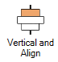
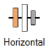

1. Next, let’s try using the Adjoin feature, which makes it easy to put objects together. Select all the shapes and click the button under the Adjoin group.
Fats
Protein
Fruits
Vegetables
1. Positions Lab also has a Distribute feature, which helps you evenly distribute objects on your slide. Select the human figures in the order: blue, orange, red, green, and click
the button.

Slide 35
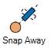
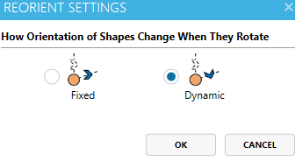
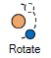
1. The Reorient feature helps you set the orientation of your objects easily. Just select the object to be your reference object, followed by the other objects. Select the sun,
followed by the 3 arrows and click the button.
2. Next, click the settings button for the Reorient section.
Select for Dynamic in the settings and click OK.
Select the sun, followed by the 3 arrows and
click the button. Click on any arrow and try dragging it around!
To find out more about Positions Lab, please refer to PowerPointLabs documentations.

Slide 36
Next, let’s try using Resize Lab

Slide 37

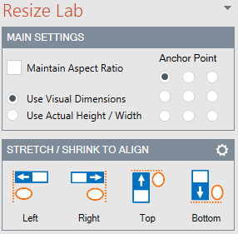

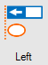
1. Click the button to open the Resize Lab pane at the right side of your screen.
We will first try the “Stretch / Shrink to Align” feature.
2. Select the 4 colored arrows, with B1.1 being the first to be selected.
(Click on B1.1, then ctrl-click A1.1, A2.1, and A3.1)
A1
A1.1
B1
B1.1
A2
A2.1
3. Click the button under “Stretch / Shrink to Align”
A3
A3.1

Slide 38




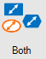
1. Let’s try the “Equalize” feature. First select the 3rd box, and then select the remaining boxes.
Select this first
Select these next (ctrl-click)
2. Click the button. All boxes will now have the same dimensions as the 3rd box, which was the first object selected.

Slide 39
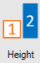



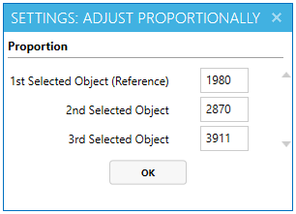
1. Lastly, let’s try the “Adjust Proportionally” feature. Select the leftmost giraffe, followed by the second, and the rightmost (using ctrl-click).
2. Click the button. A dialog box will appear. Enter 1980, 2870, and 3911 into the first, second, and third text field respectively. Click OK, or press the Enter key.
4000
3911
3000
2870
2000
1980
1000
1995
2005
2015
Giraffe population over the years
To find out more about Resize Lab, please refer to PowerPointLabs documentations.

Slide 40
Next, let’s try using Colors Lab

Slide 41

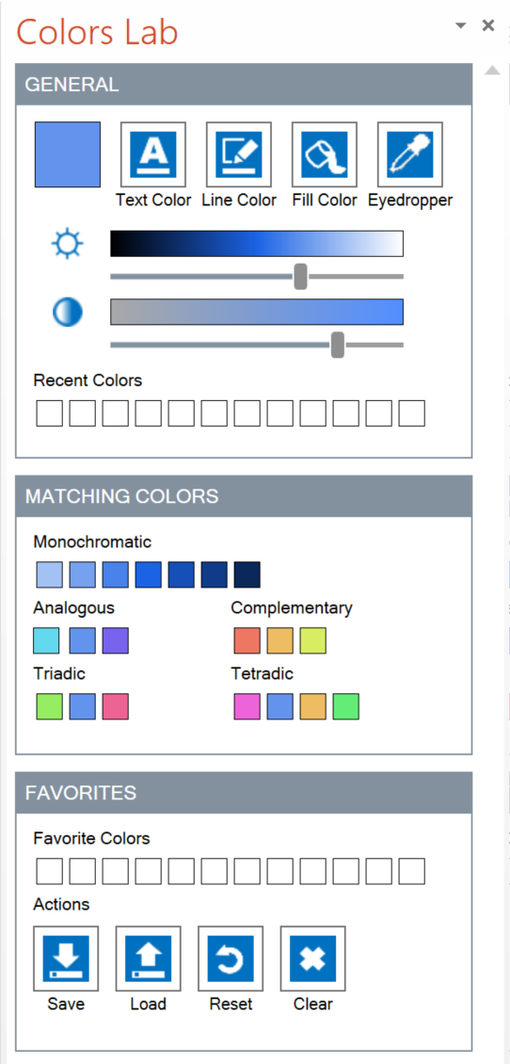

1. Click the button to open the Colors Lab Pane at the right side of your screen.
2. Click on your Colors Lab pane to change the main color of the pane.
Drag the same button to pick a color from the surrounding area (it works like a color picker).
You can use it to pick colors even from outside the PowerPoint window.
As you change the main color, other colors in the pane change to give show you matching colors to the one you picked.

Slide 42



3. Select the shape below:
Select me!
4. Drag the button in the pane to change the selected shape’s font color.
Drag the button to change its line color,
or button to change its fill color.
Tip: Clicking any of those three buttons let you choose a color from the standard color palette.
To find out more about Colors Lab, please refer to PowerPointLabs documentations.

Slide 43
S
Next, let’s try using Sync Lab
S
Sync Lab makes your slides more consistent by allowing you to choose the individual shape formats to save and apply across your slides

Slide 44

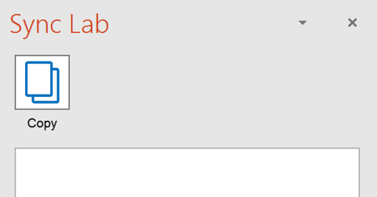
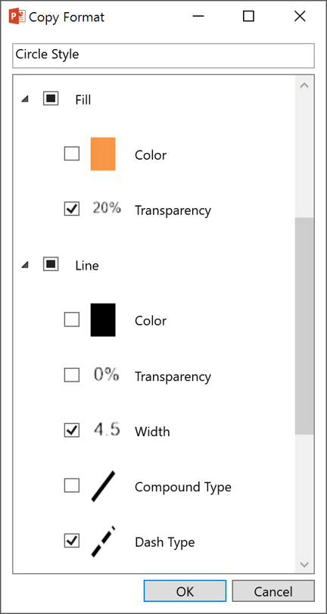
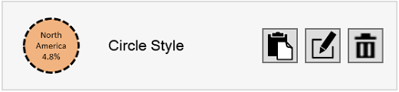
1. Click the button, it will bring out the Sync Lab pane.
2. To copy the formats of a shape,
select the shape below and click the button. Select the following formats:
Fill Transparency
Line Width
Line Dash Type
Rename the style from
“Oval 1” to “Circle Style” and click OK.
North America
4.8%
3. You should see appear on the Sync Lab pane.
Notes:
When selecting a shape, ensure that the shape is selected, not the text in the shape

Slide 45

4. Now we are ready to apply the copied formats on some objects. Select all the circles on the map and click the button. All the circles should have the format elements we copied in the previous step.
Asia
59.6%
North America
4.8%
Africa
16.6%
South America
8.6%
To find out more about Sync Lab, please refer to PowerPointLabs documentations.

Slide 46
Next, let’s try using Shapes Lab

Slide 47

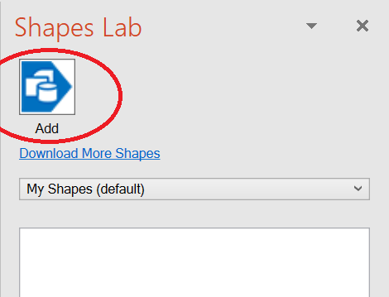
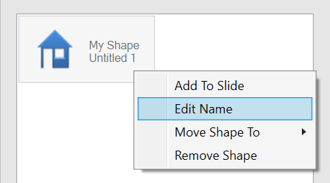
1. Click the button to open the Shapes Lab pane at the right side of your screen. Select the ‘house’ shape.
2. Click the add button
3. To delete or rename the saved shape, right-click and choose the appropriate action from the context menu.

Slide 48
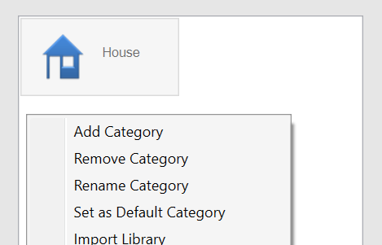
4. Double-click the ‘House’ shape in the Shapes Lab pane to add a copy of it to this slide.
5. Right-click an empty area of the Shapes Lab to change the location where shapes are saved.
Tip: Save shapes in a shared folder (e.g. a Dropbox folder) to share saved shapes among multiple computers.
To find out more about Shapes Lab, please refer to PowerPointLabs documentations.

Slide 49

Next, let’s try using Crop Lab

Slide 50


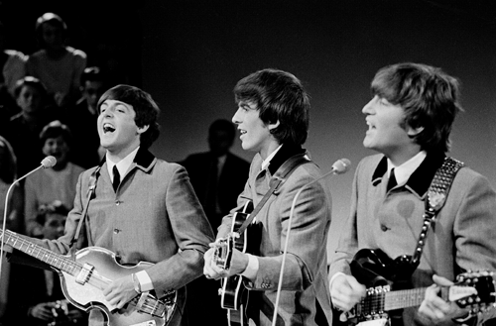
Crop To Shape
1. Select the blue shape below, click the button select .
2. Delete this picture, and you are now left with the shape area cropped out from the picture!

Slide 51


Crop To Slide
This slide has a very large picture! Since the excess area outside of the slide is not shown during your slide show, let’s crop it within the slide.
1. Select the picture below, click the button select .
Tip: Your picture can be adjusted further using PowerPoint’s Crop feature.

Slide 52


Crop Out Padding
This slide has a picture with transparent background, but the transparent area is too large and making it hard to select other objects on the slide! Let’s trim away the extra padding.
1. Select the picture below, click the button and select .
To find out more about Crop Lab, please refer to PowerPointLabs documentations.

Slide 53

Next, let’s try using Paste Lab
Paste Lab can be found both on the ribbon and the right-click context menu. Copy this picture (using right-click -> Copy or ctrl-c) to get started.

Slide 54



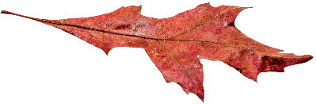
Paste Into Group
1. Click this group of pictures, click the button and select .
2. Press the button to see that the animations of the group are preserved even after pasting. Paste Lab preserves the animations when pasting objects.
Tip: Paste Lab’s features works when pasting objects in PowerPoint even if the object is copied from outside of PowerPoint.

Slide 55

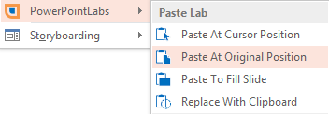
Paste To Cursor Position
1. Right-click this spot and select Paste To Cursor Position under PowerPointLabs.
To find out more about Paste Lab, please refer to PowerPointLabs documentations.

Slide 56

Next, let’s try using Timer Lab
Timer Lab allows you to create a custom timer for any slide with a single click

Slide 57

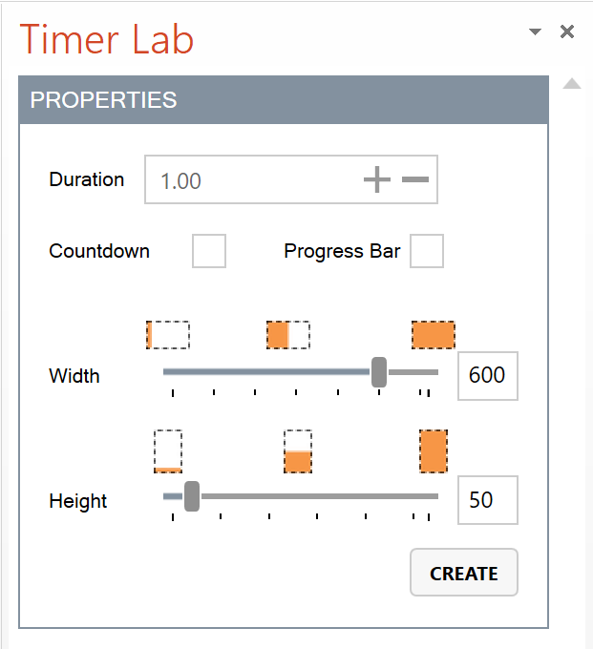
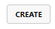
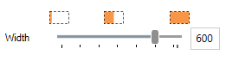
1. Click the button, it will open out the Timer Lab pane at the right side of your screen.
Click the button to create a timer in the middle of the slide. Note that you can only have one timer per slide.
0
10
20
30
40
50
60
2. There are several customization options available for the timer. You can use the panel to resize or change the duration of your timer.
Let’s try to change the width of the timer using . Adjust the width of the timer to 400 using the slider. You should see the timer change in real time as you move the slider. You can also use the textbox to change the width. Click anywhere on the Timer Lab pane to register the change.
To find out more about Timer Lab, please refer to PowerPointLabs documentations.

Slide 58
a
Next, let’s try using Agenda Lab
Agenda Lab creates agenda slides based on the sections in your presentation

Slide 59


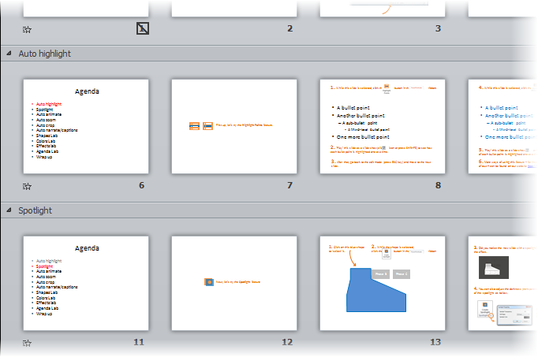
Create Text Agenda
1. Click the button and select .
That will insert agenda slides into the slide deck. Items in the agenda slides will correspond to the names of the slide sections.

Slide 60

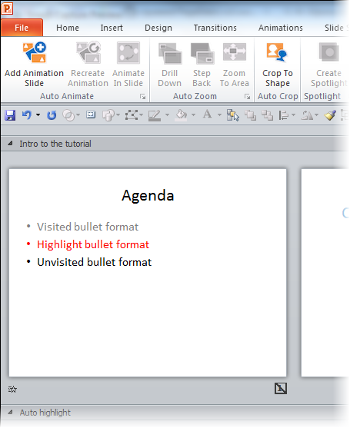
Synchronize Agenda
1. Agenda Lab also inserts a hidden ‘Template’ slide at the beginning of the slide deck. That slide can be used to tweak the appearance of the agenda slides, as explained in the next slide.
Template slide

Slide 61
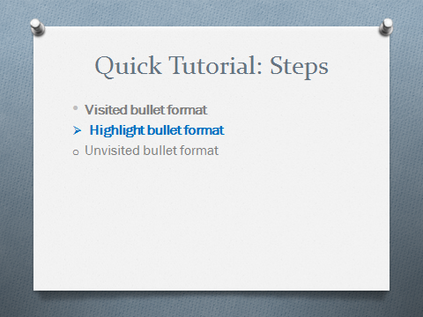
2. First, modify the agenda slide to match the appearance you want the agenda slides to have.
3. Then, click the button and select to regenerate all agenda slides to match the template slide.

Slide 62

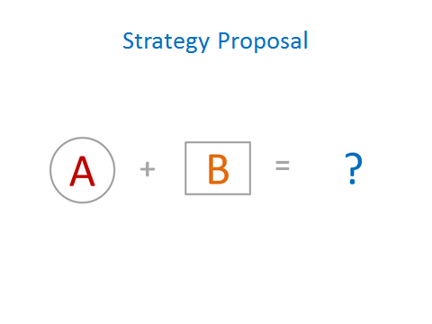
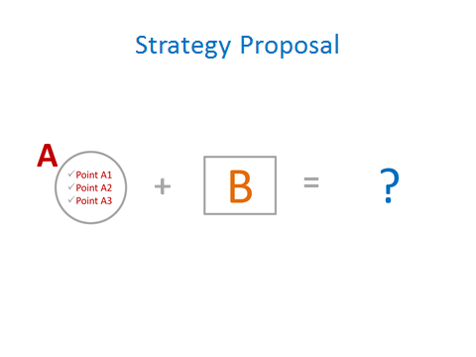

Create Visual Agenda
1. It is possible to generate agenda slides containing a visual representation of the topics.

Slide 63




Create Sidebar Agenda
1. It is also possible to insert the agenda as a sidebar on each slide. Here are two examples:
Remove Agenda
1. Click the button and select to remove all generated agenda slides from your presentation.
To find out more about Agenda Lab, please refer to PowerPointLabs documentations.

Slide 64



Finally, let’s try using Picture Slides Lab
Notes:
[[Picture taken from https://flic.kr/p/5s5APp on 3/19/2016 4:47:38 PM]]

Slide 65



1. Go to the next slide and click the button.
It will show the Picture Slides Lab window. Choose a slide preview in the preview area and click the apply button to apply the style to current slide.
2. To customize slide previews, click the customize button. It will show you how the slide will look like with the various pictures you have on the picture collection area (the right half of the PSL window).
3. To add more pictures, click + and choose more pictures from your computer hard disk.
4. To tweak the design further, choose which aspect you want to tweak.
To find out more about Picture Slides Lab, please refer to PowerPointLabs documentations.

Slide 66
Learning is a never-ending journey.
Picture Slides Lab
Demo Slide
Notes:
Picture Slides Lab Demo Slide

Slide 67

Thanks for taking the quick tutorial.
For find more information about these features, visit the documentation on our website.
To give feedback or ask a question, contact us at pptlabs@comp.nus.edu.sg
Happy PowerPointing!

